Slide 1
On The Seashore

Slide 2
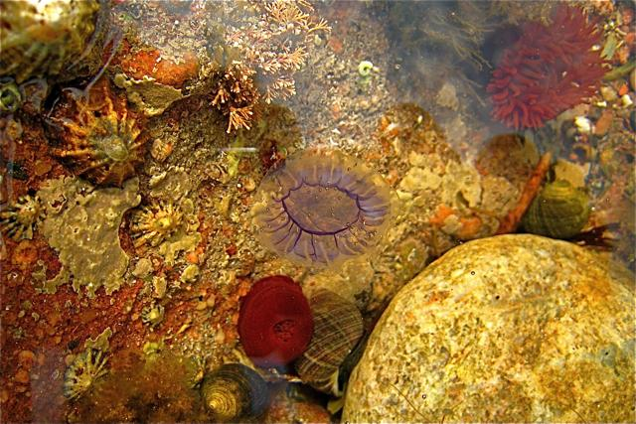
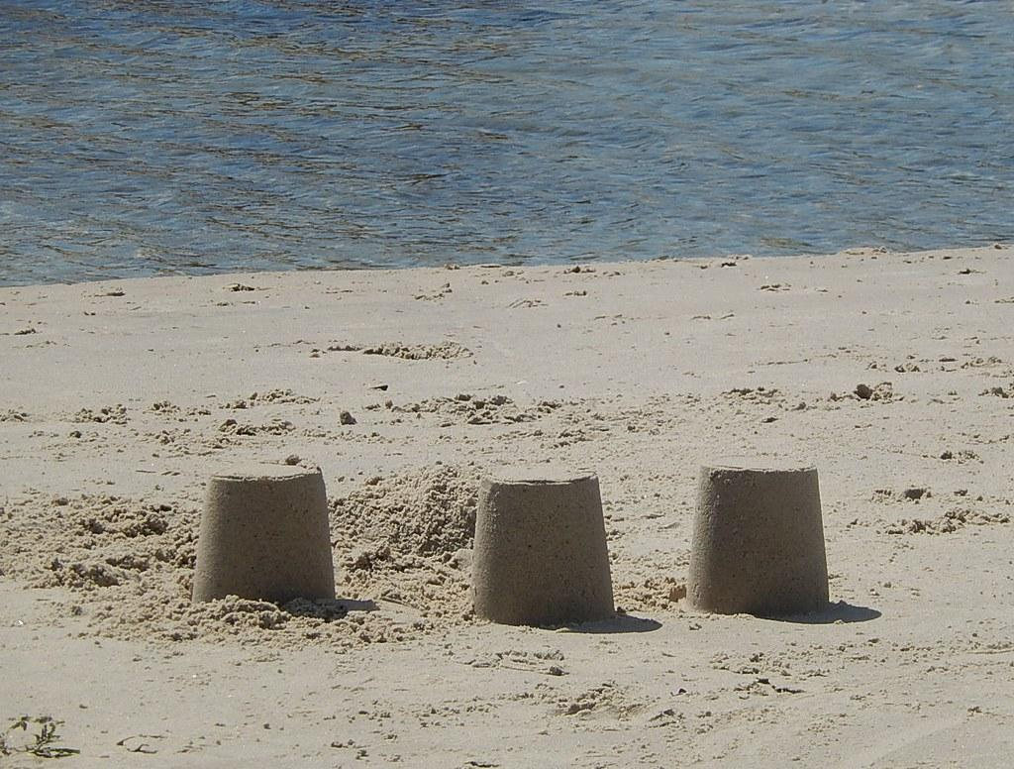
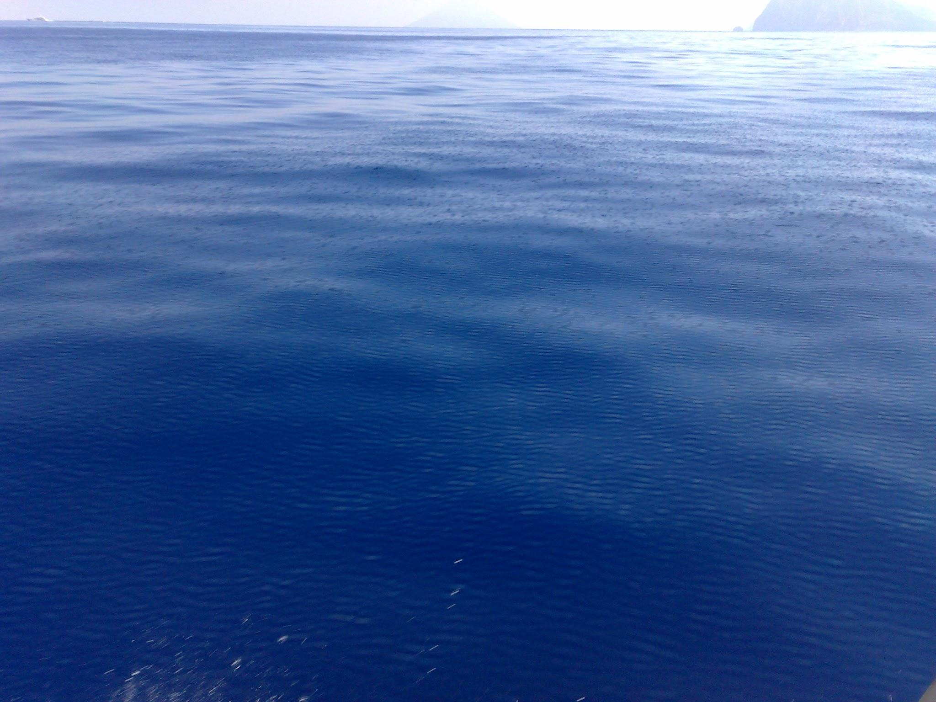
Introduction
At the seashore you can play, build a sandcastle, have a picnic and swim in the sea.
You can look in rockpools

Slide 3
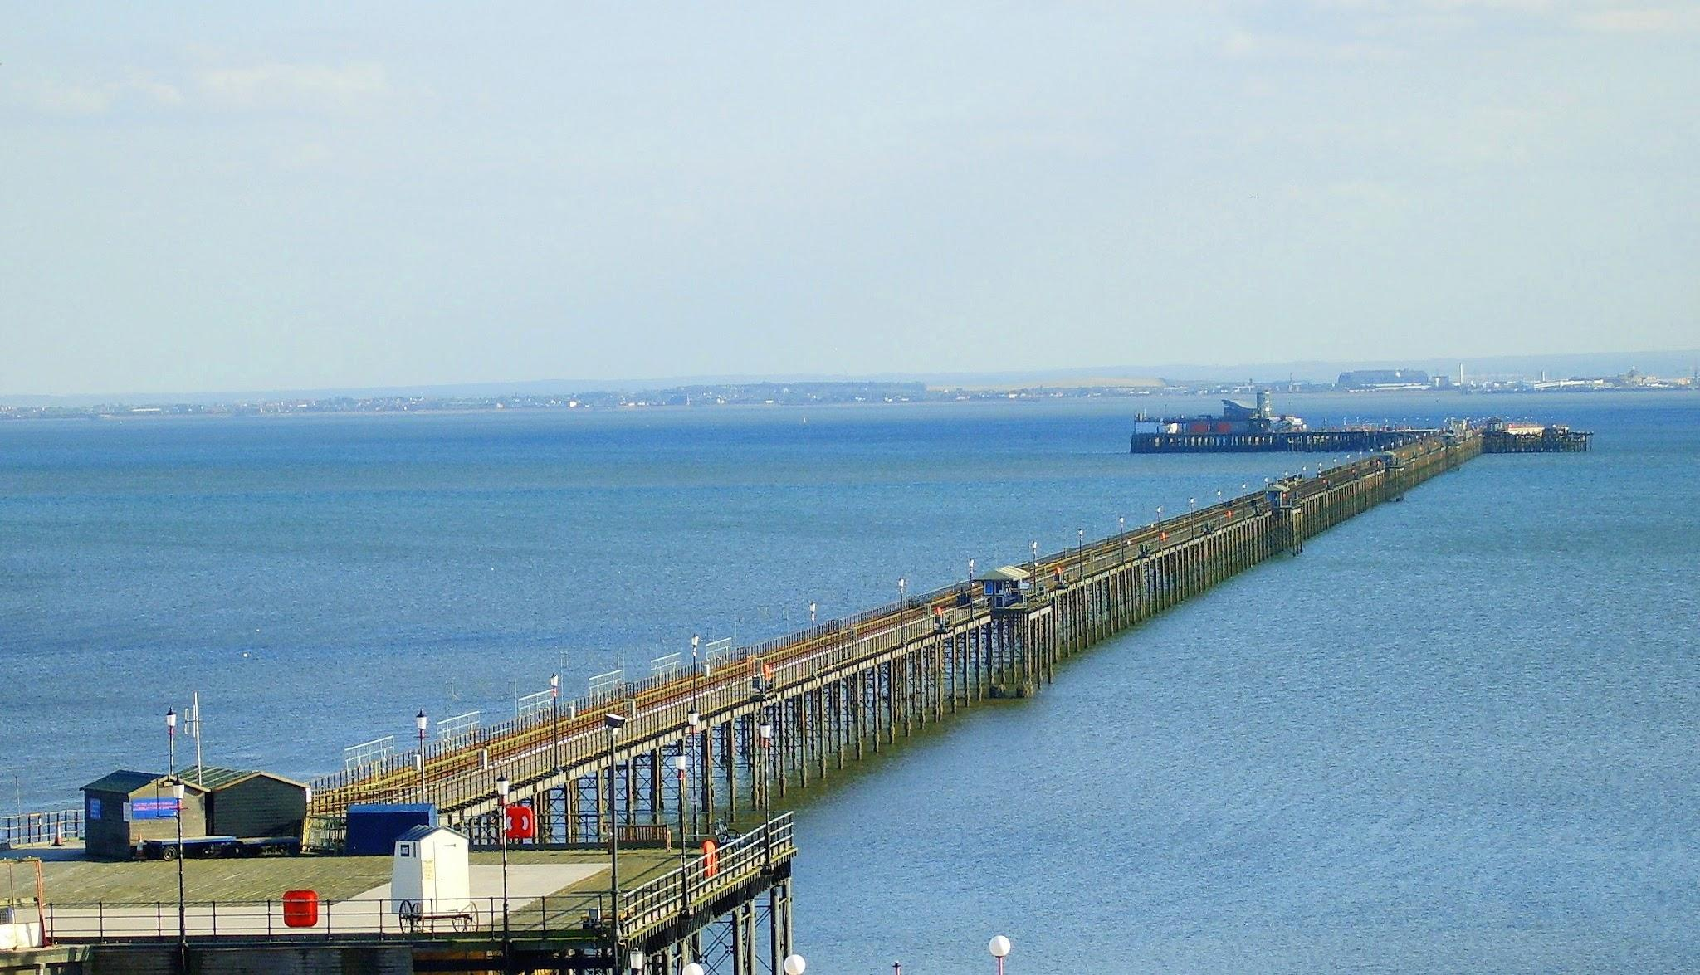
Human features
Human features are made by humans.
Houses and roads are human features.
pier

Slide 4
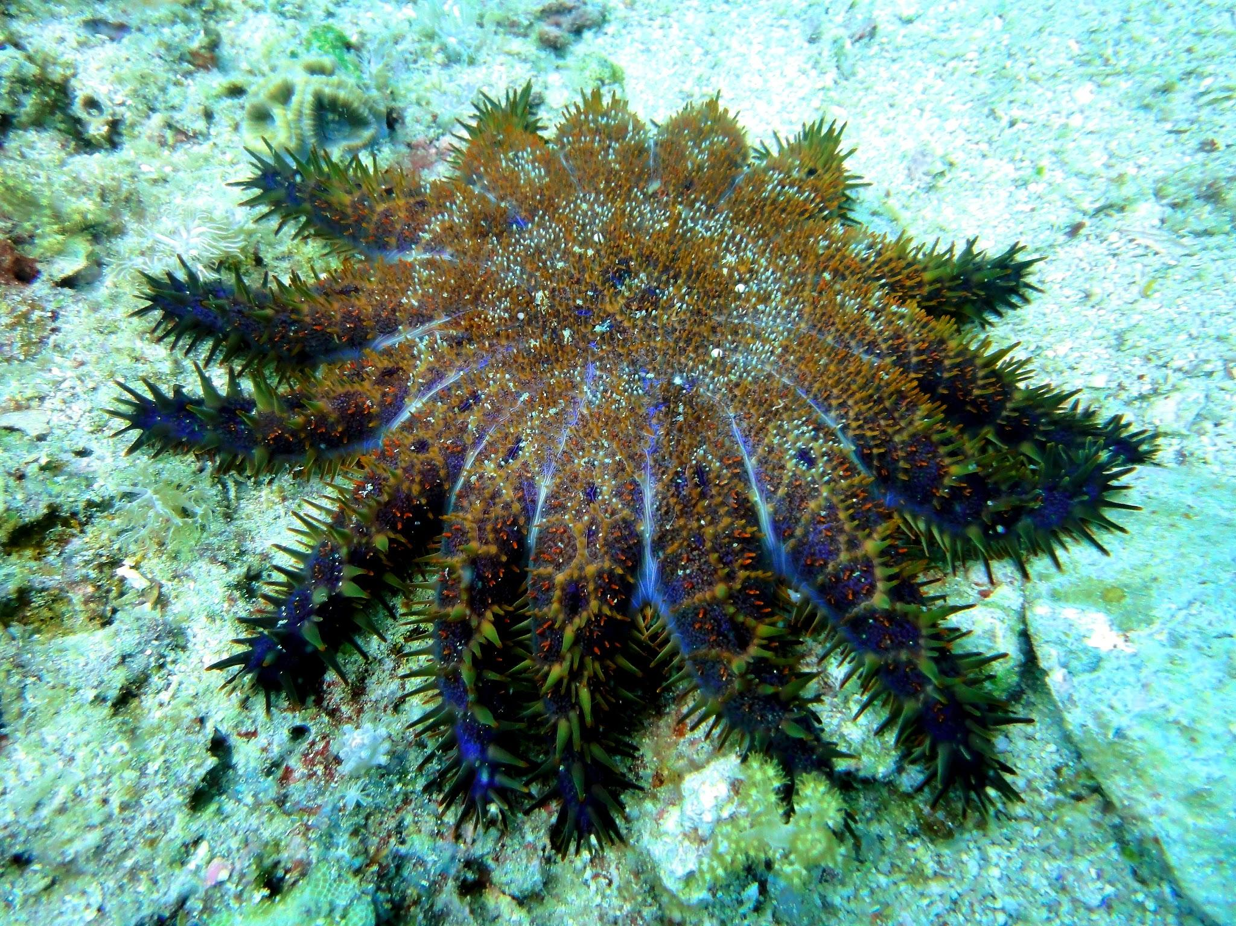
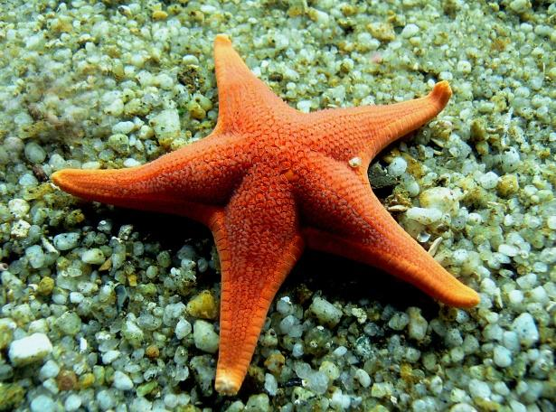
Sea creatures
Starfish normally have five arms but some have more. When one of their
arms fall off they grow back.

